Slide 1
ML Algorithm Review
Jie Tang
Department of Computer Science & Technology
Tsinghua University

Slide 2





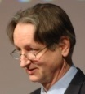









The State of Machine Learning
Classification models
Maximal Margin
Maximal margin sequential learning
Decision tree
Bayesian classifier
Perceptron
Neural networks
SVM
(Vapnik)
M3N network
(Ben Taskar)
Topic models
Deep learning
PLSI, LDA, etc.
Deep belief networks
Sequential learning
Sequential learning
Graphical models
HMM
MEMM, CRF,
voted perceptron
Factor graph,
Exponential model
For more from http://aminer.org/
Notes:
John Ross Quinlan (Sydney U.->RuleQuest)
Svm: John Shawe-Taylor
Deep learning: Geoffrey Hinton (DNN), Yoshua Bengio (DNN), Andrew Ng, Yann LeCun (CNN)
TM: thomas hofmann, Padhraic Smyth,
HMM: math (Leonard Esau Baum),
GM: Brendan J. Frey, Zoubin Ghahramani (Iran, in Cambridge), daphne koller, Michael Jordan

Slide 3
Basic ML Algorithm Review
Basic algorithms review
Data representation
Supervised learning
Evaluation
Regression, Perceptron, Bayesian classificaiton, Decision tree, etc.
Unsupervised learning
K-means, K-medoid
Semi-supervised learning
Learning with labeled and unlabeled data
Active learning, Transfer learning

Slide 4
The first example—KNN

Slide 5
K-Nearest Neighbor Learning
k-NN is a type of instance-based learning, or lazy learning where the function is only approximated locally and all computation is deferred until classification
Given a training set S={(x₁, y₁),(x₂, y₂),…,(x_{N}, y_{N})}, and x_{i}∈X=R^{m}, i=1,2,…,N, classify objects based on closest training examples in the feature space.
Properties of kNN
No explicit hypothesis
No training stage
Distance function

Slide 6
1-Nearest Neighbor
Class +1
Class 0

Slide 7
3-Nearest Neighbor
Class +1
Class 0

Slide 8
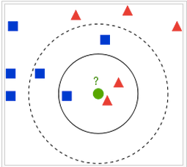
Properties
First Class
Second Class
The test sample (green circle) should be classified either to the first class of blue squares or to the second class of red triangles.
If k = 3 (solid line circle) it is assigned to the second class because there are 2 triangles and only 1 square inside the inner circle.
If k = 5 (dashed line circle) it is assigned to the first class (3 squares vs. 2 triangles inside the outer circle).

Slide 9
Another example—Decision Tree

Slide 10
Training Dataset
This follows an example from Quinlan’s ID3
Notes:
John Ross Quinlan (Sydney U.->RuleQuest)

Slide 11
Output: A Decision Tree for “buys_computer”
age?
<=30
overcast
>40
30..40
student?
yes
credit rating?
no
yes
excellent
fair
no
yes
no
yes

Slide 12
Algorithm for Decision Tree Induction
Basic algorithm (a greedy algorithm)
Tree is constructed in a top-down recursive divide-and-conquer manner
At start, all the training examples are at the root
Attributes are categorical (if continuous-valued, they are discretized in advance)
Examples are partitioned recursively based on selected attributes
Test attributes are selected on the basis of a heuristic or statistical measure (e.g., information gain)
Conditions for stopping partitioning
All samples for a given node belong to the same class
There are no remaining attributes for further partitioning – majority voting is employed for classifying the leaf
There are no samples left

Slide 13
Attribute Selection Measure: Information Gain (ID3/C4.5)
Select the attribute with the highest information gain
S contains s_{i} tuples of class y_{i} for i = {1, …, m}
information measures info required to classify any arbitrary tuple
entropy of attribute A with values {a₁,a₂,…,a_{v}}
information gained by branching on attribute A
Notes:
Then how can we decide a test attribute on each node?
One of the popular methods is using information gain measure, which we covered in chapter 5.
It involves rather complicated equations, and I’ll not present the details here. Just basic ideas.
The basic idea is that we select the attribute with the highest information gain.
This information gain can be calculated from the expected information I and entropy of each attribute, E
I : the expected information needed to classify a given sample
E (entropy) : expected information based on the partitioning into subsets by A

Slide 14
Attribute Selection by Information Gain Computation
Class P: buys_computer = “yes”
Class N: buys_computer = “no”
I(p, n) = I(9, 5) =0.940
Compute the entropy for age:
means “age <=30” has 5 out of 14 samples, with 2 yes’es and 3 no’s. Hence
Similarly,

Slide 15
Extracting Classification Rules from Trees
Represent the knowledge in the form of IF-THEN rules
One rule is created for each path from the root to a leaf
Each attribute-value pair along a path forms a conjunction
The leaf node holds the class prediction
Rules are easier for humans to understand
Example
IF age = “<=30” AND student = “no” THEN buys_computer = “no”
IF age = “<=30” AND student = “yes” THEN buys_computer = “yes”
IF age = “31…40” THEN buys_computer = “yes”
IF age = “>40” AND credit_rating = “excellent” THEN buys_computer = “yes”
IF age = “<=30” AND credit_rating = “fair” THEN buys_computer = “no”

Slide 16
Evaluation—Supervised Learning

Slide 17
Supervised Learning
* x_{i} is a vector and x_{ik} represents the k-th feature of example x_{i}

Slide 18
Evaluation
Type I error
Accuracy on test set
The rate of correct classification on the testing set. E.g., if 90 are classified correctly out of the 100 testing cases, accuracy is 90%.
Error Rate on test set
The percentage of wrong predictions on test set
Confusion Matrix
For binary class values, “yes” and “no”, a matrix showing true positive, true negative, false positive and false negative rates
 |  | Predicted class
 |  | Yes | No
Actual class | Yes | True positive (TP) | False negative (FN)
 | No | False positive (FP) | True negative (TN)
Type II error
Notes:
分类模型的评估主要通过测试数据集的精度和错误率，精度描述的是分类模型在测试数据集上分类正确的样本的比例；错误率则相反，描述的是分类错误的百分比，具体计算的时候一般通过建立一个混淆矩阵来实现。这里的右边给出了混淆矩阵的建立方法，上面的两列表示模型预测的正样本和副样本，左边描述的是测试集中的正样本和副样本，而矩阵中的四个元素分别表示为TP、FN、FP和TN。TP分别表示在测试集中本身的类标号就是正而分类模型预测的值也是正，FN表示在测试集中是正而模型预测的是副，FP表示在测试集中的类标号是副而模型预测的时候正，TN则表示的是测试集中是副而模型预测的也是副。
最后可以通过以下公式计算精度和错误率。

Slide 19
Evaluation Techniques
Holdout: the training set/testing set.
Good for a large set of data.
k-fold Cross-validation (交叉验证):
Divide the data set into k sub-samples.
In each run, use one distinct sub-sample as testing set and the remaining k-1 sub-samples as training set.
Evaluate the method using the average of the k runs.
This method reduces the randomness of training set/testing set.
Notes:
在评估的时候，首先要保证测试集和训练集的独立性，其次还要避免测试集和训练集选择的随机性，因此通常采用k-fold交叉验证方法，也翻译成k折交叉验证。该方法是首先将数据集分为k份，然后每次都使用其中的k-1份进行训练，剩下的1份进行测试，依次循环k次，最后用k次的平均值作为最终的评估结果。K-fold交叉验证方法可以有效的降低数据划分的随机性。

Slide 20
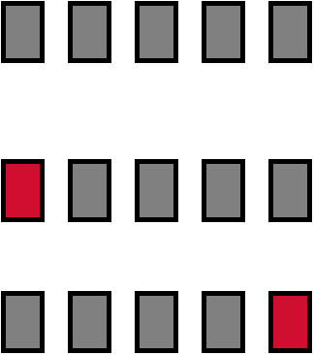
Cross Validation: Holdout Method
Break up data into groups of the same size
Hold aside one group for testing and use the rest to build model
Repeat
iteration
Test
Large k results in a small bias but large variance
Notes:
这里用一个图例来说明交叉验证方法的过程，这是一个5-折交叉验证方法，首先将数据均分为5份，然后执行5次
第一次的时候取第一份作为测试集，其他四分作为训练集，然后评估训练得到的模型的精度，
第二次则取第二份作为测试集，依次类推。最后5次实验的平均值作为分类模型在该数据集上的精度。

Slide 21
A general case

Slide 22
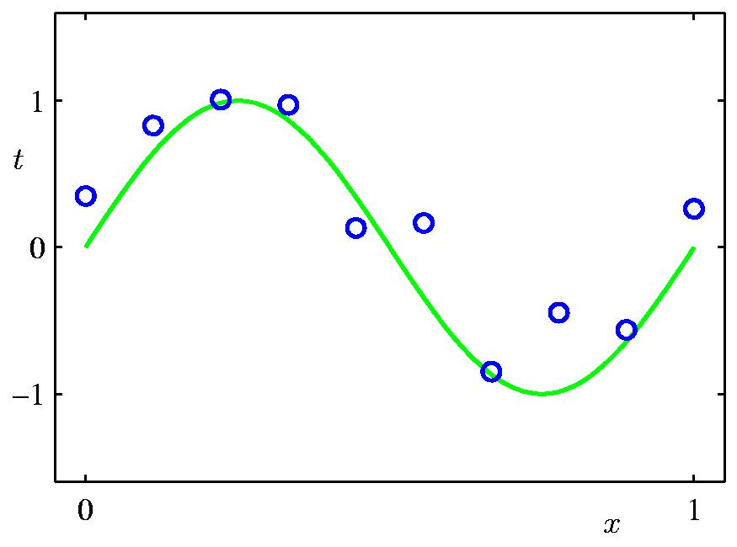
Polynomial Curve Fitting
?
As the first step, we need to decide how we’re going to represent the function f.
One example: polynomial curve fitting
Notations:
w₀+w₁x₁
w^{T}x
Now, given a training set, how do we pick, or learn, the parameters w?

Slide 23
Least Squares Loss Function
^{y}_{i}
f(x_{i}, w)

Slide 24
Learning by Gradient Descent
How to choose w in order to minimize L(w)?
General idea is to start with some “initial guess” for w, and then repeatedly changes w to make L(w) smaller, until we converge to a value of w that minimize L(w).
^{Gradient descent is a natural} ^{search algorithm that update} w in the direction of steepest decrease of L:
^{where △ is the learning rate}
Now let us calculate the partial derivative.
First consider one training instance (x, y), so the sum in L can be ignored:
The rule is called LMS (least mean squares) update rule, aka Widrow-Hoff learning rule.
Intuition: The update is proportional to the error term (f(x, w) - y). Thus for the training examples with prediction score close to the actual value y, there is little need to change the parameters; in contrast, a larger change to the parameters will be made.

Slide 25
Learning by Gradient Descent (cont.)
Then consider a training data set rather than only one example by two ways:
^{Batch gradient descent}
Scan through the entire training set before taking a single step of update
Repeat until convergence {
w_{k} = w_{k} - α_{t} ∑_{i} ( f (x_{i}, w) – y_{i}) x_{ik}
}
^{Stochastic gradient descent}
Start making progress right away, and continues to make progress with each example it looks at.
^{Much faster than batch} ^{gradient descent.}
The parameters will keep oscillating around the minimum of L, but in practice most of the values near the minimum will be reasonably good approximations to the true minimum.
Repeat until convergence {
Random select a sample x_{i} {
w_{k} = w_{k} - α_{t} ( f (x_{i}, w) – y_{i}) x_{ik}
}
}
Particularly when the training set is large, stochastic gradient descent is often preferred.
The learning rate α_{t} decreases with the iteration time t.

Slide 26
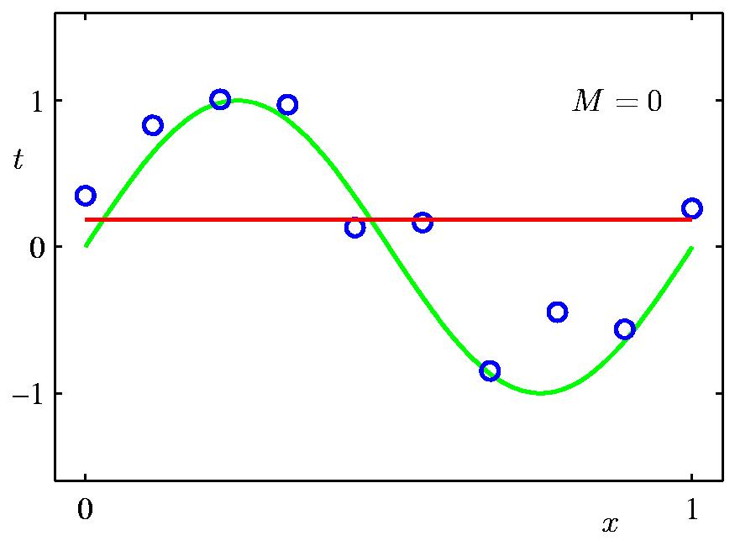
0th Order Polynomial
* A number of the following pages are from Bishop’s slides

Slide 27
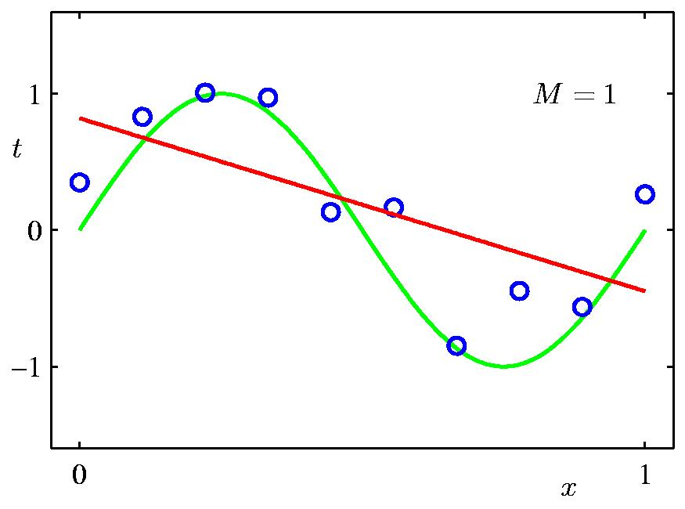
1st Order Polynomial

Slide 28
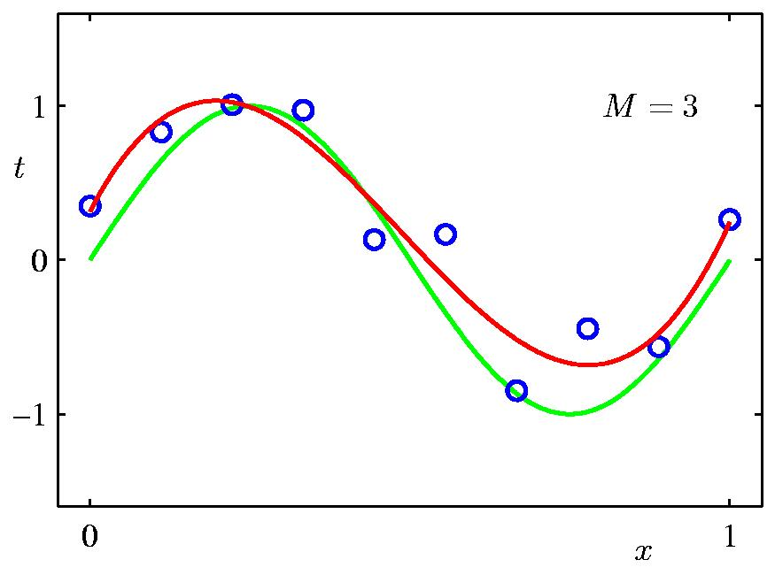
3rd Order Polynomial

Slide 29
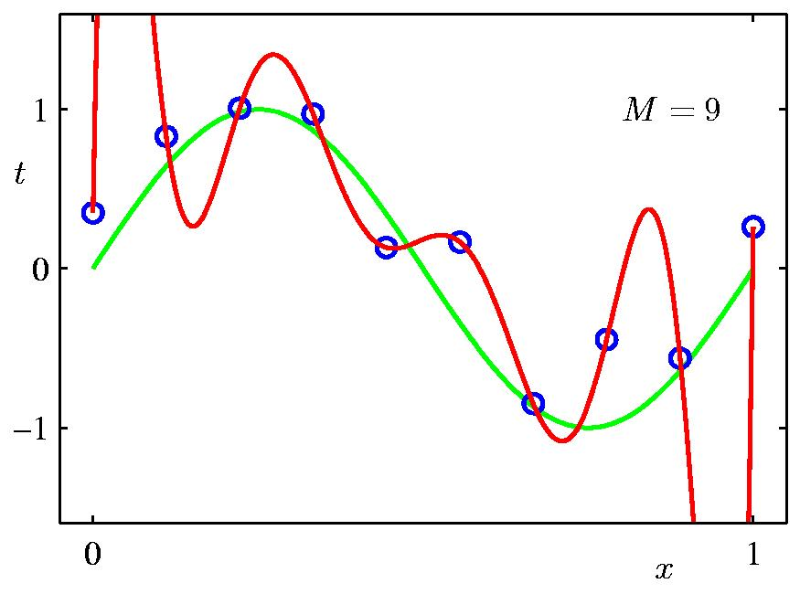
9th Order Polynomial

Slide 30
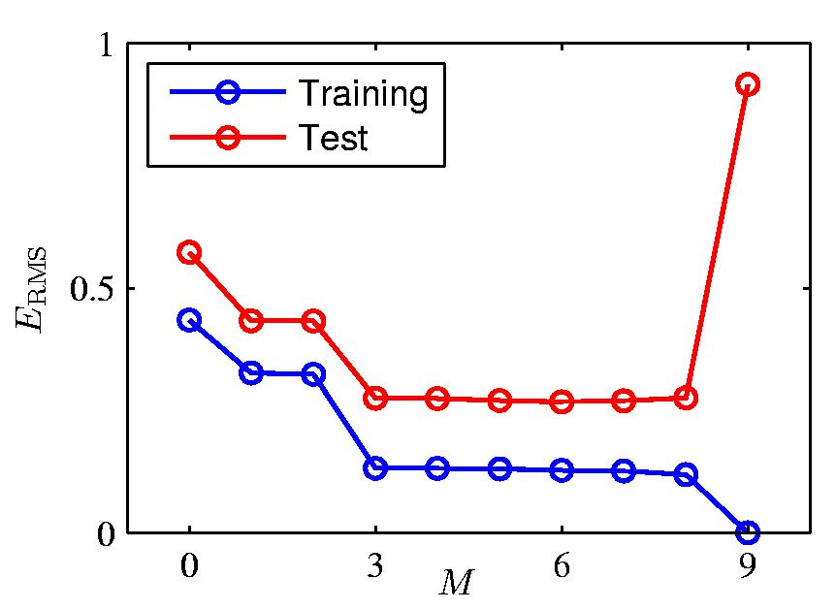
Over-fitting
Root-Mean-Square (RMS) Error:

Slide 31
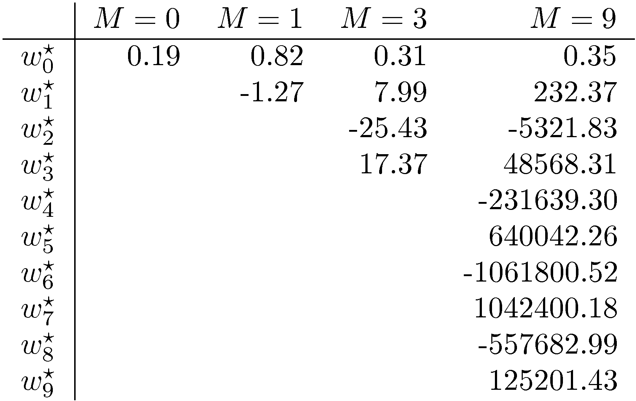
Polynomial Coefficients

Slide 32
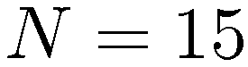
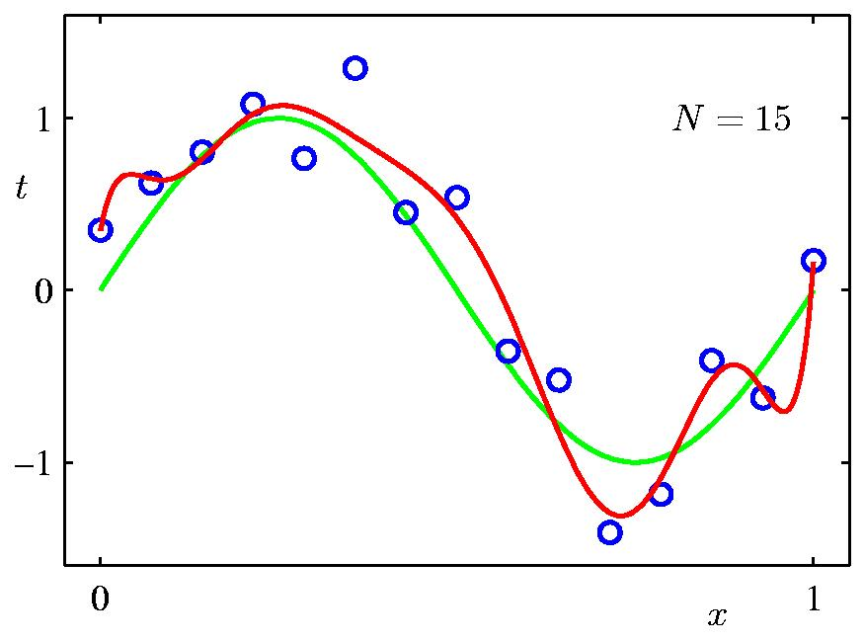
Solution 1: Increasing Data Volume
9th Order Polynomial

Slide 33
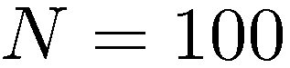
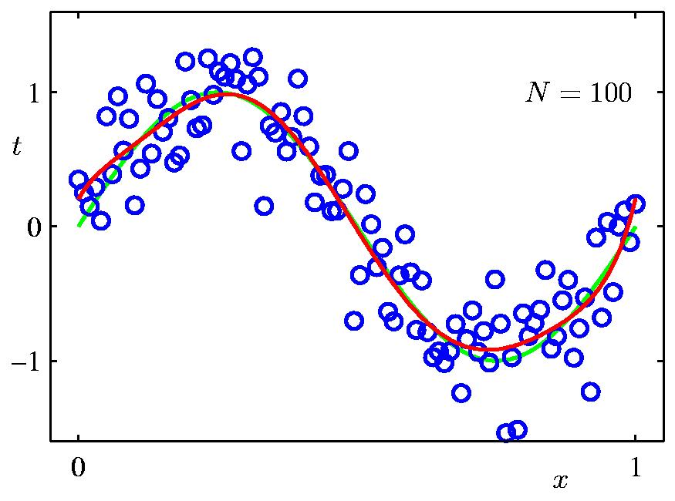
Data Set Size
9th Order Polynomial

Slide 34
Solution 2: Regularization
Penalize large coefficient values

Slide 35
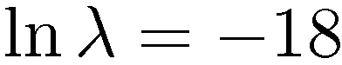
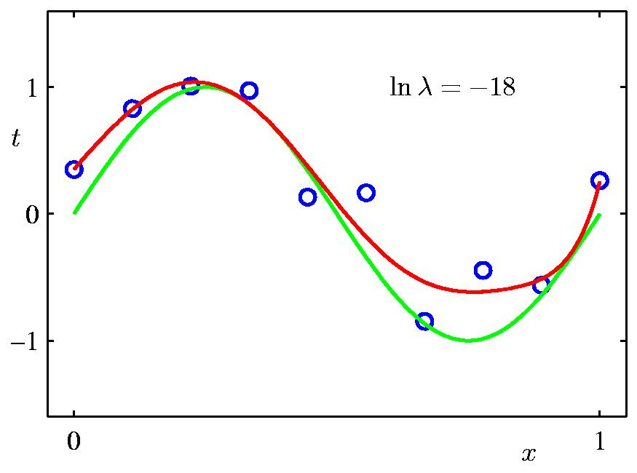
Regularization

Slide 36
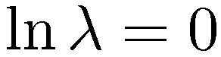
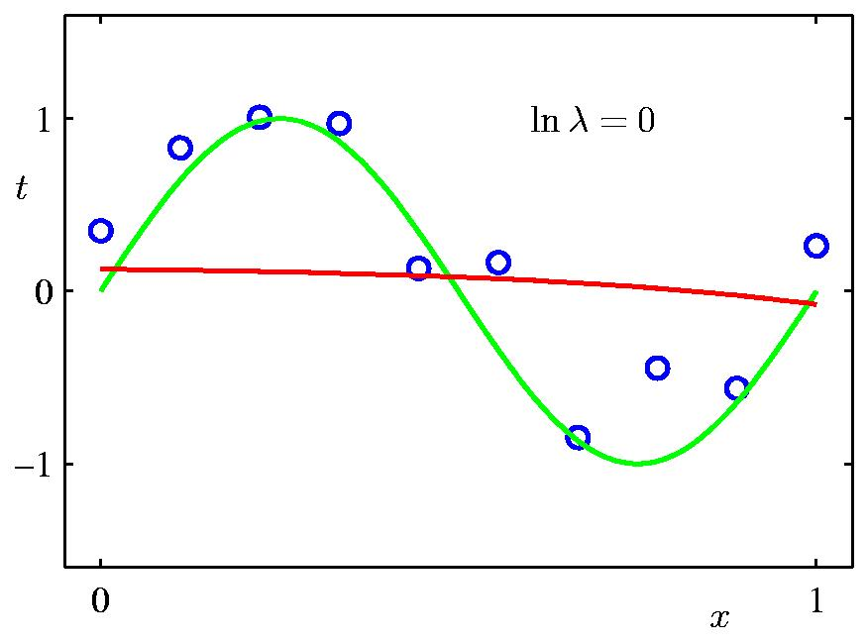
Regularization

Slide 37
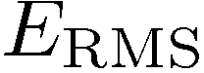

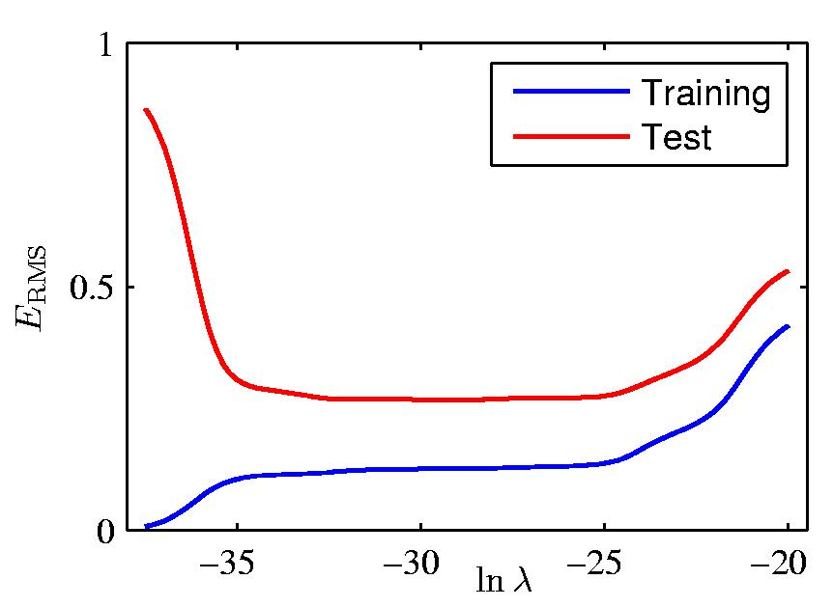
Regularization: vs.

Slide 38
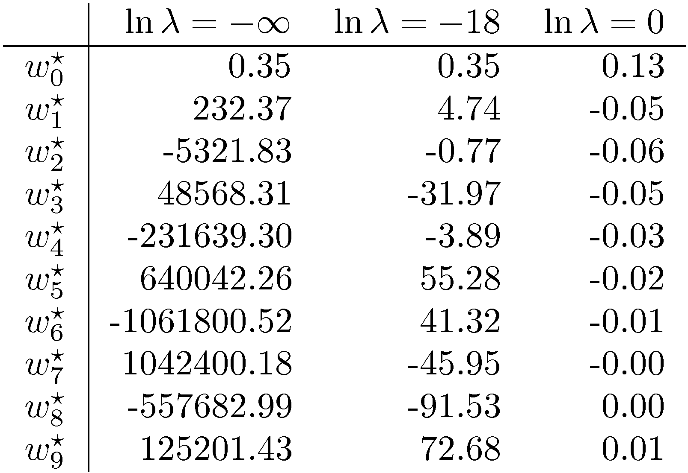
Polynomial Coefficients

Slide 39
Classification—Perceptron

Slide 40
Perceptron—a linear model
Consider a two-class, linearly separable classification problem
We are looking for a linear function
i.e.,
Class +1
Class -1

Slide 41
Rosenblatt’s Perceptron
The Rosenblatt’s perceptron algorithm considers each training point in turn, adjusting the parameters to correct any mistakes
The algorithm will converge (no mistakes) if the training points are linearly separable through origin; otherwise it won’t converge
Initialize: w=0;
Repeat until convergence:
for i=1,…,m
if y_{i} (w·x_{i}) ≤ 0 then
w ←w + y_{i} x_{i}

Slide 42
Perceptron: property on update
If we make a mistake on x_{i}
After the update, we have
So that increases based on update

Slide 43
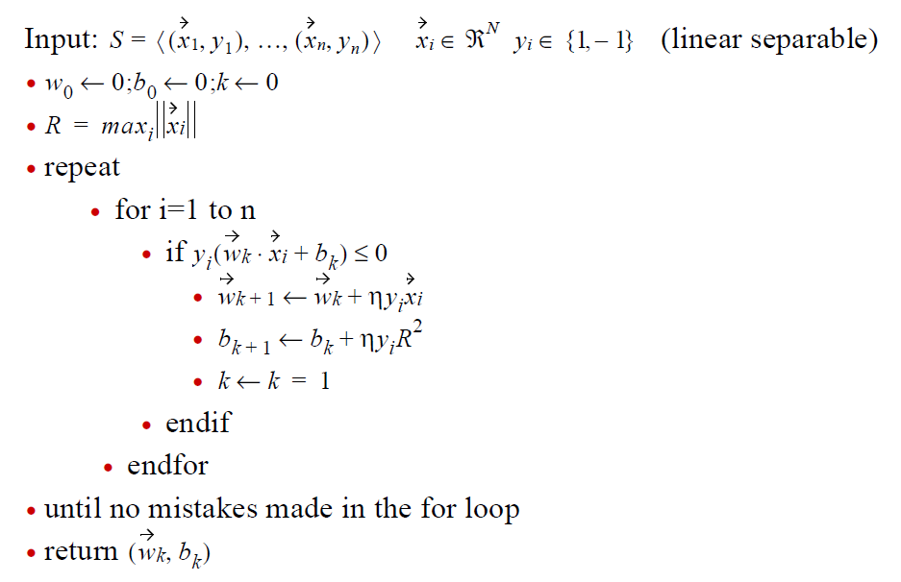
Rosenblatt’s Algorithm

Slide 44
Update by minimizing LMS
Still consider minimizing the least squares loss function
Then we obtain the update rule

Slide 45
Classification—Logistic Regression

Slide 46
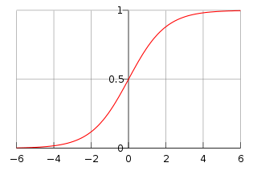
Logistic Regression
Classification is like the regression problem, except that the values y take on (a small number of) discrete values. Let us first consider the binary case (binary logistic regression):
Logistic or sigmoid function
How to fit w for logistic regression model?
i.e.,
Then we can obtain the log likelihood
Notes:
We get predicted value y as 0 or 1 when we use linear regression, since will take values >1 or < 0.
If we want predicted value 1>y >0, change the hypotheses to g(z) which is called logistic function or sigmoid function.

Slide 47
Maximum Likelihood Estimation
We could learn w by maximizing the log likelihood using gradient ascent
This is because
Hence, the update rule is
The update rule looks identical with LMS, but not the same, because f(x, w) is now defined as a non-linear function.

Slide 48
Classification—Bayesian Classification

Slide 49
Bayesian Theorem
Given training data X, posteriori probability of a hypothesis Y, P(Y|X) follows the Bayes theorem
Informally, this can be written as
posteriori = likelihood x prior / evidence
MAP (maximum posteriori) hypothesis
Practical difficulty: require initial knowledge of many probabilities, significant computational cost

Slide 50
Naïve Bayes Classifier
A simplified assumption: attributes are conditionally independent:
No dependence relation between attributes
Greatly reduces the computation cost, only count the class distribution.
Once the probability P(x_{i}|y) is known, assign x_{i} to the class y with maximum P(x_{i}|y) * P(y)

Slide 51
Training dataset
Class:
y=1:buys_computer=
‘yes’
y=0:buys_computer=
‘no’
Data sample
x =(age<=30,
Income=medium,
Student=yes
Credit_rating=
Fair)

Slide 52
Naïve Bayesian Classifier: An Example
Compute P(x_{i}|y=1), P(x_{i}|y=0) for each class
P(age=“<30” | buys_computer=“yes”) = 2/9=0.222
P(age=“<30” | buys_computer=“no”) = 3/5 =0.6
P(income=“medium” | buys_computer=“yes”)= 4/9 =0.444
P(income=“medium” | buys_computer=“no”) = 2/5 = 0.4
P(student=“yes” | buys_computer=“yes)= 6/9 =0.667
P(student=“yes” | buys_computer=“no”)= 1/5=0.2
P(credit_rating=“fair” | buys_computer=“yes”)=6/9=0.667
P(credit_rating=“fair” | buys_computer=“no”)=2/5=0.4
x=(age<=30 , income =medium, student=yes, credit_rating=fair)
P(x|y) : P(X|buys_computer=“yes”)= 0.222 x 0.444 x 0.667 x 0.0.667 =0.044
P(X|buys_computer=“no”)= 0.6 x 0.4 x 0.2 x 0.4 =0.019
P(x|y)*P(y ) : P(X|buys_computer=“yes”) * P(buys_computer=“yes”)=0.028
P(X|buys_computer=“no”) * P(buys_computer=“no”)=0.007
Therefore, x belongs to class “buys_computer=yes”

Slide 53
Naïve Bayesian Classifier: Comments
Advantages
Easy to implement
Good results obtained in most of the cases
Disadvantages
Assumption: class conditional independence, therefore loss of accuracy
Practically, dependencies exist among variables
E.g., hospitals: patients: Profile: age, family history etc
Symptoms: fever, cough etc., Disease: lung cancer, diabetes etc
Dependencies among these cannot be modeled by Naïve Bayesian Classifier
How to deal with these dependencies?
Bayesian Belief Networks

Slide 54
Classification—Neural Network

Slide 55
A Neuron (= a perceptron)
-
μ_{k} Bias
x₀
w₀
x₁
w₁
∑
f
output y
x_{n}
w_{n}
Input
vector x
weight
vector w
weighted
sum
Activation
function
Logistic or sigmoid

Slide 56
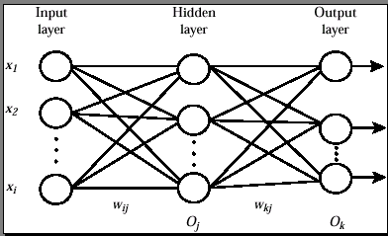
Multi layer Neural Network

Slide 57
Network Training
The ultimate objective of training
obtain a set of weights that makes almost all the tuples in the training data classified correctly
Steps
Initialize weights with random values
Feed the input tuples into the network one by one
For each unit
Compute the net input to the unit as a linear combination of all the inputs to the unit
Compute the output value using the activation function
Compute the error
Update the weights and the bias

Slide 58
Back Propagation
Output vector
Output nodes
K
Hidden nodes
j
w_{ij}
Input nodes
i
Input vector: x_{i}

Slide 59
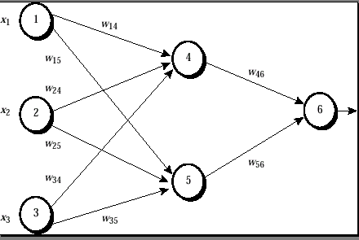
Back Propagation

Slide 60
One example
Input: X={1,0,1}, output: 1
X1=1, x2=0, x3=1,
w14=0.2, w15=-0.3,
w24=0.4, w25=0.1,
w34=-0.5, w35=0.2,
w46=-0.3, w56=-0.2,
Bias: node 4:-0.4, node 5:0.2, node 6:0.1
Learning rate l=0.9

Slide 61
One example
Node 4:
input :w14*x1+w24*x2+w34*x3+bias of node 4=1*0.2+0.4*0-0.5*1-0.4=-0.7
output:
O₄=0.332
The same: node 5: input: 0.1, output:0.525
Node 6:
input :w46*o4+w56*o5+bias of node 6=-0.3*0.332-0.2*0.525+0.1=-0.105
output:0.474

Slide 62
One example
Node 6:
0.474*(1-0.474)*(1-0.474)=0.1311
Node 5:
0.525*(1-0.525)*0.1311*(-0.2)=-0.0065
Node 4:-0.0087

Slide 63
One example
W46:
-0.3+(0.9)(0.1311)(0.332)=-0.261
Other Wij is the same with w46
Bias of node 6:
0.1+(0.9)*(0.1311)=0.218
Other bias is the same with node 6

Slide 64
Other ML Scenarios

Slide 65
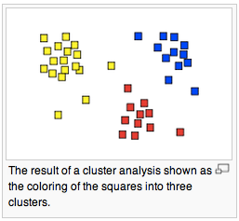

Clustering
Cluster analysis or clustering is the task of assigning a set of objects into groups (called clusters) so that the objects in the same cluster are more similar (in some sense or another) to each other than to those in other clusters.
1. Social network analysis
In the study of social networks, clustering may be used to recognize communities within large groups of people.
2. News Services like Google News(below figure)
a
Similar news are grouped together.

Slide 66
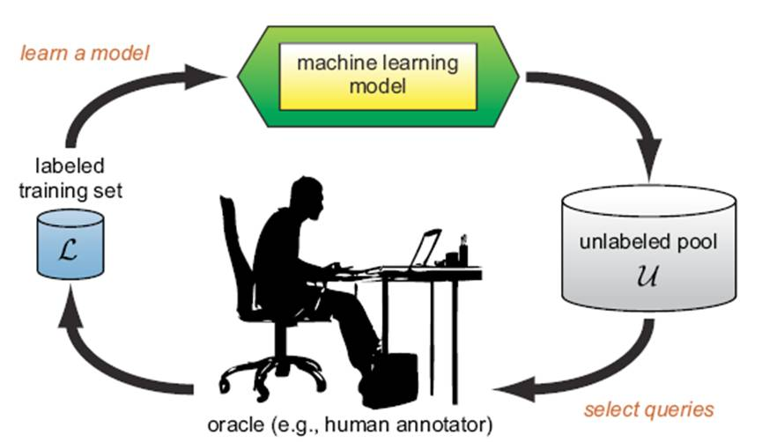
Active Learning
The key hypothesis is that if the learning algorithm is allowed to choose the data from which it learns, it will perform better with less training.
Active learning systems attempt to overcome the labeling bottleneck by asking queries from unlabeled instances to be labeled by an oracle(e.g., a human annotator).

Slide 67
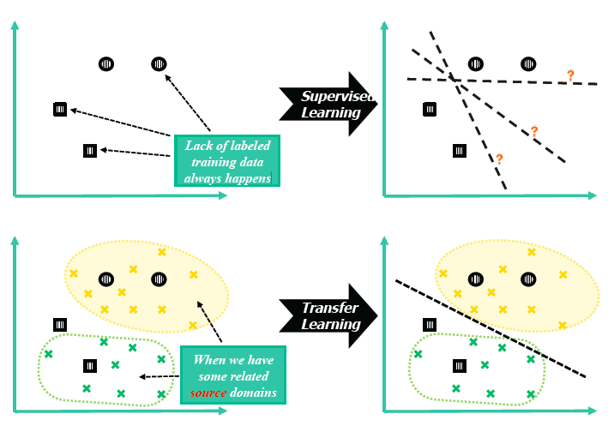
Transfer Learning
With few labels

Slide 68
Summary
Supervised Learning
KNN
Decision Tree
Perceptron
Logistic Regression
Bayesian Classification
Neural Networks

Slide 69
The State of Machine Learning
Classification models
Maximal Margin
Maximal margin sequential learning
Decision tree
Bayesian classifier
Perceptron
Neural networks
SVM
(Vapnik)
M3N network
(Ben Taskar)
Topic models
Deep learning
PLSI, LDA, etc.
Deep belief networks
Sequential learning
Sequential learning
Graphical models
HMM
MEMM, CRF,
voted perceptron
Factor graph,
Exponential model
For more from http://aminer.org/
Notes:
John Ross Quinlan (Sydney U.->RuleQuest)
Svm: John Shawe-Taylor
Deep learning: Geoffrey Hinton (DNN), Yoshua Bengio (DNN), Andrew Ng, Yann LeCun (CNN)
TM: thomas hofmann, Padhraic Smyth,
HMM: math (Leonard Esau Baum),
GM: Brendan J. Frey, Zoubin Ghahramani (Iran, in Cambridge), daphne koller, Michael Jordan

Slide 70
Thanks!
Jie Tang, DCST
http://keg.cs.tsinghua.edu.cn/jietang/
http://aminer.org
Email: jietang@tsinghua.edu.cn

